Slide 1
Welcome to Pine Street Family Practice’s Podcasts!!
New Series of Podcasts
A Few Topics already covered
Anxiety
Diabetes
Obesity
Too come…
Hypertension
Dementia
Depression
Nutrition
What will the podcast review?
Brief information on a health topic
Definition
Signs and symptoms
Risk Factors
Treatments

Slide 2
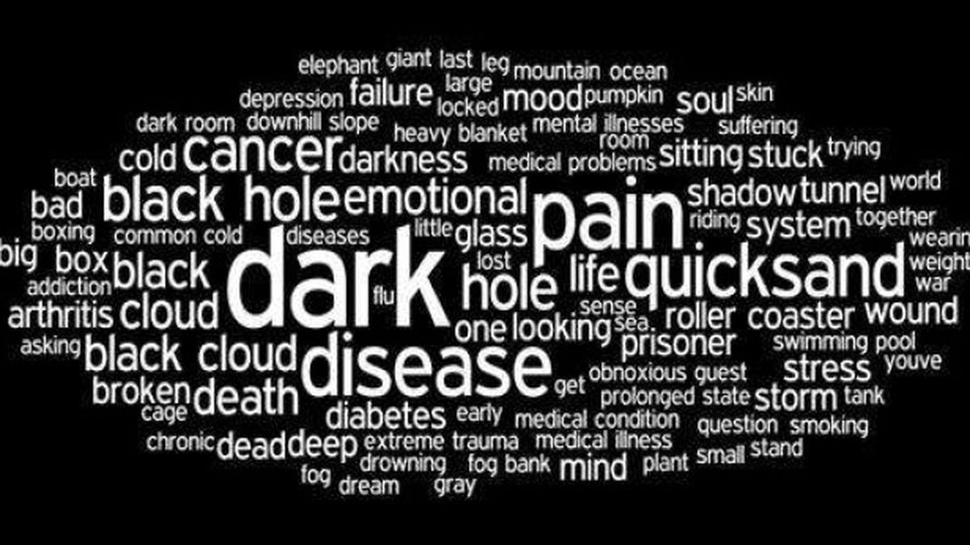
Depression
Maryanne Gallagher APN
Pine Street Family Practice

Slide 3
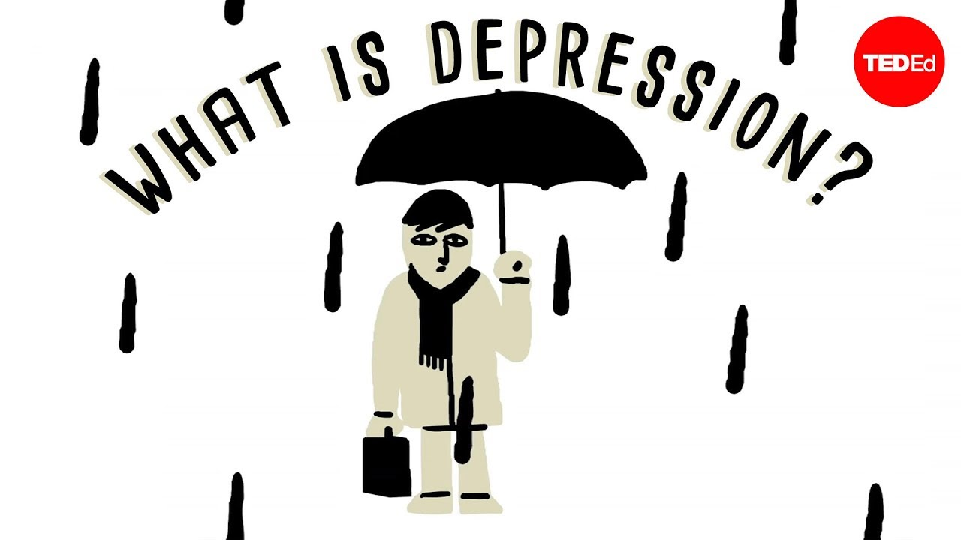
Facts
In 2019
2.8% of adults experienced severe symptoms of depression
4.2% experienced moderate symptoms
11.5% experienced mild symptoms
The highest among those aged 18–29 being 21.0%
Ages 45–64 at 8.4%
Ages 65 and over at 18.4%
Ages 30–44 at 16.8%
However since the COVID 19 pandemic started there has been an increase of depression dx and symptoms by 30.9%
Depression and COVID 19
During June of 2020, U.S. adults reported considerably elevated adverse mental health conditions associated with COVID-19. Younger adults, racial/ethnic minorities, essential workers, and unpaid adult caregivers reported having experienced worsening mental health symptoms and outcomes with increased substance use, and elevated suicidal ideation.
CDC, 2020

Slide 4
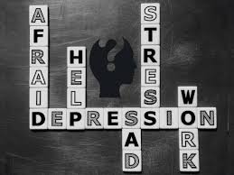
What is Depression?
Depression also considered a major depressive disorder is a common and serious medical illness that negatively affects how you feel, the way you think and how you act. Fortunately, it is also treatable.
Depression causes feelings of sadness and/or a loss of interest in activities you once enjoyed. It can lead to a variety of emotional and physical problems and can decrease your ability to function at work and at home.
Depression is different from feeling sad or grieving. The death of a loved one, loss of a job, a new onset of a chronic illness, or the ending of a relationship are difficult experiences for a person to undergo; it is common for feelings of sadness or grief to develop in response to these situation.
APA, 2020

Slide 5
Depression versus Grief
In grief, painful feelings can come in waves, often intermixed with positive memories of the decease.
In major depression, mood and/or interest (pleasure) are decreased for most of two weeks
In grief, self-esteem can usually be maintained
In major depression, feelings of worthlessness and self-loathing are common
In grief, thoughts of death may surface when thinking of joining the deceased loved one
In major depression, thoughts can focus on suicide and plans due to feelings of worthlessness or undeserving of living or being unable to cope with the pain of depression

Slide 6
Different types of Depression
Post partum depression also known as Peripartum depression
A treatable medical illness involving feelings of extreme sadness with changes in energy, sleep, and appetite which carries risks for the mother and child.
This can occur during pregnancy or following childbirth, showing more than one in nine new mothers can be affected
Seasonal Depression or Seasonal Affective Disorder (SAD)
This disorder can involve mood changes and symptoms similar to depression, symptoms usually occur during the fall and winter months when there is less sunlight and usually improve with season changes
The most difficult time of the year is January and February
Premenstrual Dysphoric Depression (PMDD)
A woman with PMDD has severe symptoms of depression, irritability, and tension about a week before menstruation begins and usually ends with onset of menses
Disruptive Mood Dysregulation Disorder
is a condition that occurs in children and youth ages 6 to 18
It involves a chronic and severe irritability resulting in severe and frequent temper outbursts
Bipolar Depression
formerly called manic depression, is a mental health condition that causes extreme mood swings that include emotional highs (mania or hypomania) and lows (depression)

Slide 7
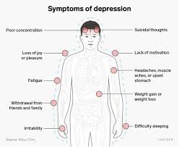
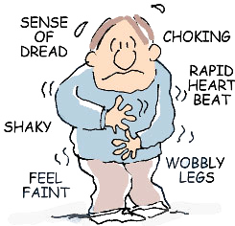
Sign and Symptoms
Physical symptoms include:
Loss of energy, no energy or fatigue
Lack of sleep, insomnia or too much sleep
Headaches, muscle aches
Changes in appetite, weight gain/loss
Emotional symptoms include:
Feeling sad and having a depressed mood
Loss of interest in activities/pleasure
Feeling worthless or guilty
Thoughts of death or suicide

Slide 8
Risk Factors
Behavioral changes in childhood and sometimes in adulthood
Being female
Having few resources
Exposure to stressful life events in childhood and adulthood
Genetic predisposition from close biological relatives
Health issues such as diabetes, heart disease
NIMH, 2020

Slide 9
Causes

Slide 10
Causes
BRAIN CHEMISTRY
Differences in certain chemicals in the brain may contribute to symptoms of depression.
the hippocampus, a small part of the brain that is important for storing memories, this appears to be smaller in some people with a history of depression than in those who've never been depressed. A smaller hippocampus has fewer serotonin receptors. Serotonin is one of many brain chemicals known as neurotransmitters that allow communication across circuits that connect different parts of the brain involved in processing emotions
GENETICS
Depression can run in families. For example, if one identical twin has depression, the other has a 70% chance of having the illness
STRESS
Continuous exposure to violence, neglect, abuse or poverty may make some people more vulnerable to depression. The connection between stress and depression is complex.
When stressed one can neglect healthy lifestyle practices. They may smoke, drink more than normal, and neglect regular exercise.
NAMI, 2020

Slide 11
Causes
POOR NUTRITION
There are some common nutrient deficiencies associated with depression, iron, Vitamin D, Omega-3 fatty acids, Folate, Vitamin B, magnesium, and iodine which is why it’s very important to take a multivit daily.
PHYSICAL HEALTH ISSUES
Some chronic illnesses can cause depression, like, chronic pain, DM, heart disease, kidney disease, HIV/AIDS, MS and Hypothyroidism can lead to depression.
SUBSTANCE USE AND ABUSE
Nearly 30% of people with substance abuse problems can also have a dx of depression
NAMI, 2020

Slide 12
Treatment
Depression is among the most treatable of mental disorders
Similar to anxiety, popular and successful treatments are through medication and psycho therapy.
Medication can be prescribed – it is not a quick process
Medications will start off at a low dose and evaluated monthly for effectiveness
Antidepressants can help to modify the brain chemistry, these medications are not sedatives and can have no stimulating effect on people not experiencing depression.
Antidepressants may produce some improvement within the first week or two of use yet full benefits may not be seen for two to three months. Often more then one medication will be recommended due to the severity of the symptoms. This can be difficult and frustrating to people.
It is very important to let your provider know if a medication does not work or if you experience side effects
Sometimes patients will see a psychiatrist for medication management due to the complexity of treatment
Light therapy can be helpful for SAD or seasonal depression 20 minutes under a bright light during the winter months.

Slide 13
Treatment – Psychotherapy - CBT
Psychotherapy also know as Talk Therapy
This treatment is sometimes used alone for symptoms of mild depression
for moderate to severe depression this is often used in conjunction with antidepressant medications
This therapy works to minimize or eliminate adverse behavioral symptoms allowing a person to heal psychologically
Cognitive behavioral therapy (CBT)
CBT is a form of therapy focused on the problem solving in the present, it combines theory and techniques behind both cognitive and behavioral therapies. The approach was created by examining the relationship between a person’s negative thoughts, fears, behaviors, and physical responses to various experiences.
CBT helps a person to recognize distorted or negative thinking patterns with the goal of changing those thoughts and behaviors and responding to some different challenges in a more positive manner. Retraining the brains response to thinking negatively.

Slide 14
Treatment – Medication
Medications can help relieve symptoms
Medication can only be prescribed by a medical doctor (such as a psychiatrist or a primary care provider)
can be used as the initial treatment of an depression disorder, or are used only if there is insufficient response to a course of psychotherapy.
In research studies, combination treatments of psychotherapy and medication have had better outcomes then single treatment of psychotherapy or medication alone.
Mayo Clinic,2020

Slide 15
How can we manage symptoms
Meditation
can help people calm themselves and may enrich the effects of therapy
Making time for self care is critically important
Exercise
has a calming effect, although currently, the quality of the studies is not strong enough to support its use as a confirmed treatment
During the Pandemic gyms have been closed or limited capacity, walking in the house or around one’s property is also an option and so is dancing, just move!
a half hour of moderate exercise 5 days a week is recommended
Avoid certain substances
caffeine, certain illicit drugs, and even some over-the-counter cold medications can aggravate symptoms
Family
People needs to be supportive in the recovery of a person with an anxiety/depression disorder
Resources
Keep regularly scheduled visit with providers
Continue session with therapist and practice the behavioral therapies reviewed

Slide 16
Resources
In closing, people dx with depression should not feel embarrassed or ashamed
If you or a loved one is suffering especially in these uncertain times during the pandemic, help is available, do not be uncomfortable, ask for help at your next office visit at Pine Street Family Practice.
On line information is also available at:
https://www.psychiatry.org/patients-families/depression/what-is-depression
https://www.psychiatry.org/patients-families/postpartum-depression
https://www.samhsa.gov/find-help/national-helpline
National Suicide Prevention Lifeline Hours: Available 24 hours. Languages: English, Spanish
1-800-273-8255

