Slide 1

Obesity Podcast
Pine Street Family Practice
By Maryanne Gallagher APN

Slide 2
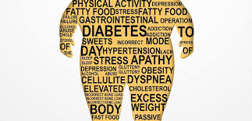
We hope you have been enjoying the Podcasts series. Welcome to our 3rd on Obesity
What is obesity? Is there a stigma?
Signs and Symptoms: BMI
Statistics on obesity
Some causes
Risk Factors
Management
Living with the diagnosis

Slide 3
Obesity stigma
Obesity has an association and stigma as an insult, it is not this at all.
Obesity is a health condition that can be treated.
Obesity does not only affect adults but also children.
Obesity is diagnosed from BMI or body mass index which is calculated from one’s height and weight.
overweight is a BMI greater than or equal to 25
obesity is a BMI greater than or equal to 30

Slide 4
Statistics on Obesity
Worldwide obesity has nearly tripled since 1975.
In 2016, more than 1.9 billion adults or 39% of the population 18 years and older, were overweight. Of these over 650 million were obese which is 13% of adults
41 million children under the age of 5 were overweight or obese in 2016.
340 million children and adolescents aged 5-19 were overweight or obese in 2016.
New Jersey statistics shows 27.3% of population are considered obese.
https://www.stateofobesity.org/adult-obesity/

Slide 5
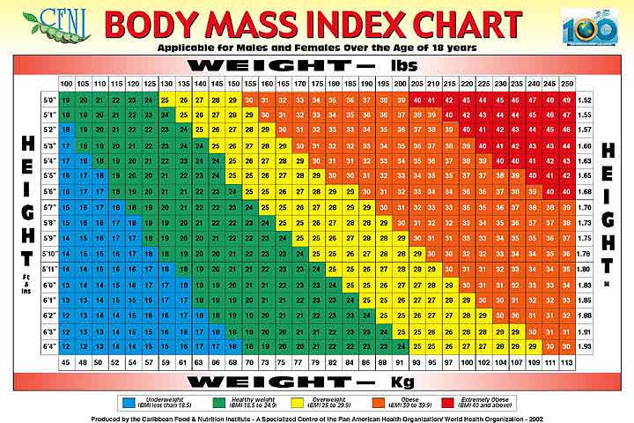
Obesity and BMI
Notes:
This is a bmi chart for you to easily see where are and determine your bmi, what is your bmi. Reduce BMI
Body mass index (BMI) is calculated using height and weight. It is used to estimate body fat.
Starting at 25.0, the higher your BMI, the greater is your risk of developing obesity-related health problems. These ranges of BMI are used to describe levels of risk:
Overweight (not obese), if BMI is 25.0 to 29.9
Class 1 (low-risk) obesity, if BMI is 30.0 to 34.9
Class 2 (moderate-risk) obesity, if BMI is 35.0 to 39.9
Class 3 (high-risk) obesity, if BMI is equal to or greater than 40.0

Slide 6
Obesity Risk Factors
High blood glucose (sugar) or diabetes.
High blood pressure (hypertension).
High blood cholesterol and triglycerides (dyslipidemia, or high blood fats).
Heart attacks due to coronary heart disease, heart failure, and stroke.
Bone and joint problems, more weight puts pressure on the bones and joints. This can lead to osteoarthritis, a disease that causes joint pain and stiffness.
Stopping breathing during sleep (sleep apnea). This can cause daytime fatigue or sleepiness, poor attention, and problems at work.
Gallstones and liver problems.
Some cancers

Slide 7
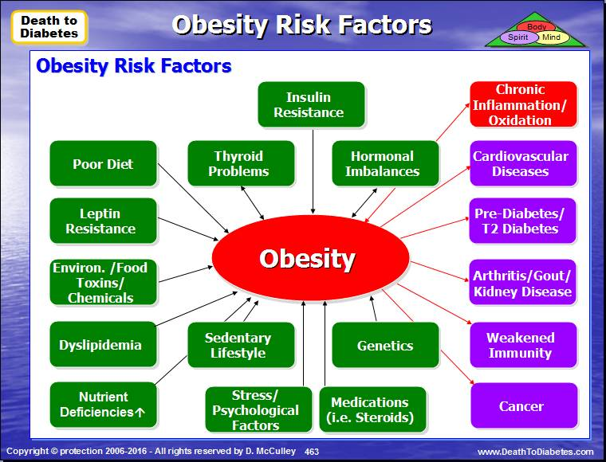
Causes

Slide 8
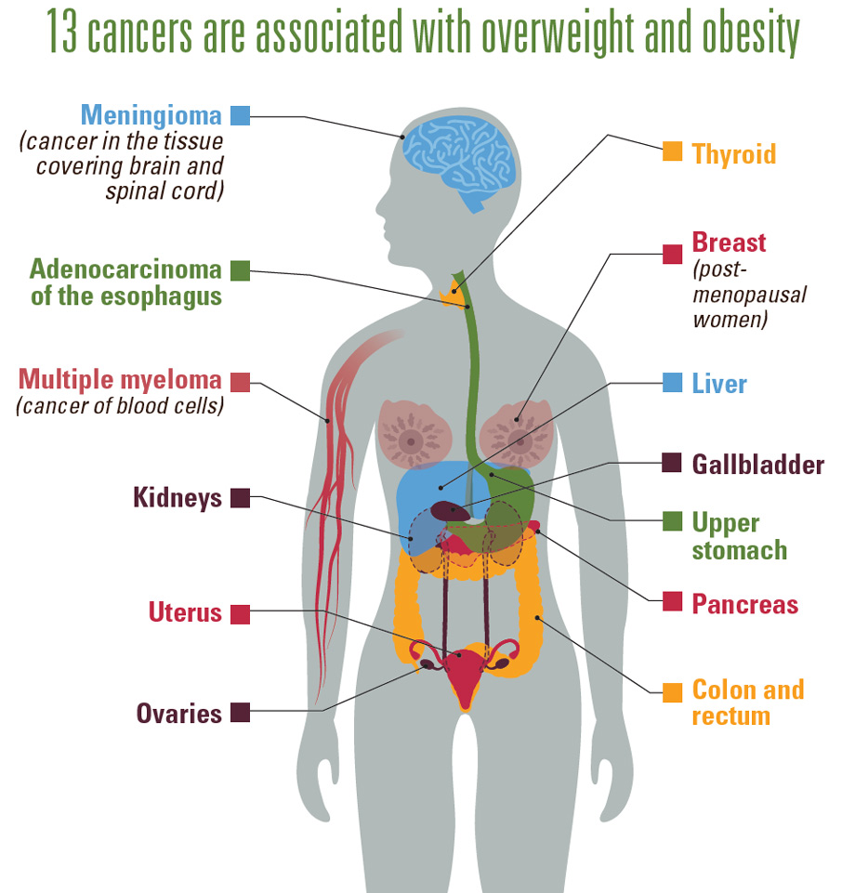

Slide 9
Treatment and Management
Lifestyle intervention is the cornerstone of all obesity treatment
Pharmacology
Surgery

Slide 10
Lifestyle
You can control many of these risk factors by changing your lifestyle. If you are diagnosed with obesity, your health care provider can help you begin a weight-loss program. A starting goal of losing 5% to 10% of your current weight will reduce your risk of developing obesity-related diseases.
1 pound = 3500 calories, reduce 500 calories a day and you can lose 1 pound a week
Exercising 20-30 minutes every other day can help burn calories although this will vary due to speed of walking/running/jogging/biking
Weight loss programs such as weight watchers can also help you decide what is best for you and provide a guide for food and activity.
Setting goals for yourself is very important such as following the acronym SMART

Slide 11
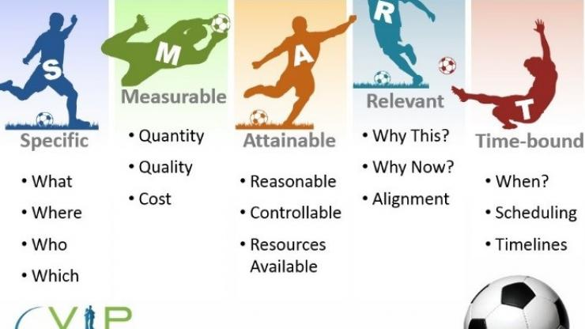
Notes:
smart technique

Slide 12
3 Most Common Surgery
Laparoscopic Roux-en-Y gastric bypass (18.7% of procedures in 2016)
Laparoscopic adjustable gastric banding (3.4%)
Laparoscopic sleeve gastrectomy (58.1%)

Slide 13
Pharmacology
Commonly prescribed weight-loss medications include:
lorcaserin (Belviq) pill form 2 times a day
promotes satiety (feeling full)
phentermine (Adipex) pill form once daily
stimulates CNS
naltrexone (Contrave) pill form max 2 tabs twice a day
blocks dopamine receptors
liraglutide (Saxenda) daily injectable
regulates appetite

Slide 14
Living beyond diagnosis
Don’t be uncomfortable talking about your weight with your provider
  Obesity is a diagnosis like any other diagnosis such as diabetes, anxiety or hypertension.
Discuss options either life style changes, medication or surgery
Make a decision to avoid future health problem
Set goals
Ask a provider at your next visit at Pine Street Family Practice what option would best fit your specific needs!

Slide 15
Resources
https://www.who.int/news-room/fact-sheets/detail/obesity-and-overweight
https://www.google.com/search?q=weight+watchers&rlz=1C1RNVH_enUS540US541&oq=weight+watchers&aqs=chrome..69i57j0l5.3042j0j7&sourceid=chrome&ie=UTF-8
https://www.weightwatchers.com/us/

