Slide 1
Welcome to Pine Street Family Practice’s 2nd Podcast
We hope you enjoyed our previous podcast on Anxiety.
Our new topic will be Diabetes.
To review the podcast will review brief information on a health topic, such as:
What is Diabetes
Signs and symptoms
Risk Factors
Management
Complications
Living with Diabetes

Slide 2
Diabetes
Pine Street Family Practice Podcast #2
By Maryanne Gallagher APN

Slide 3
Statistics on Diabetes
Prevalence or how many people are living with diabetes
30.3 million Americans, or 9.4% of the population
7.2 million were undiagnosed
12.2 million are seniors aged 65 and older
New cases: 1.5 million Americans are diagnosed with diabetes annually
Prediabetes:
84.1 million Americans age 18 and older have prediabetes
Deaths
Diabetes is the 7th leading cause of death in the United States
American Diabetes Assoc, CDC, 2018

Slide 4
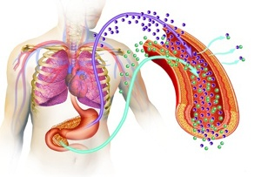
What is Diabetes?
Diabetes is a problem in the body that causes the blood sugar or glucose to elevate.
There are a few types T1, gestational, and T2 which is the most common.
In the body, the pancreas, an organ in the abdomen area, makes a hormone called insulin, insulin circulates reduces the glucose in the blood and pushes the glucose to enter cells, which is used for energy.
How does the body find glucose? There are 2 major sources, our food and our liver both stores and makes glucose. When we don’t eat or fast and our body needs glucose our liver breaks down the stored glucose called glycogen and releases it to the body to keep our level normal.
With T2 Diabetes the body doesn’t use insulin properly and then can become insulin resistant. In the beginning, the pancreas increases insulin production to try and keep up with the demand. Eventually the pancreas gets tired and can’t make enough insulin to keep the body’s glucose at a normal level and the glucose builds up and stays in the blood stream.
Center for Disease Control (CDC), 2018

Slide 5
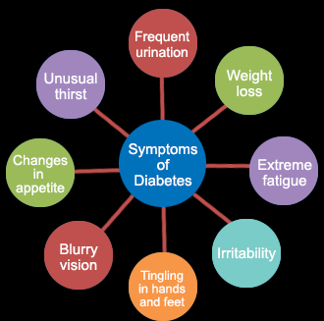
T2 Diabetes Signs and Symptoms
Increased thirst
Increased hunger especially after eating
Dry mouth
Increased and frequent urination
Sweating
Unexplained weight loss/gain when eating normally
Fatigue
Blurry vision
Slow healing cuts/sores
Frequent urination
Tingling in hands/feet

Slide 6
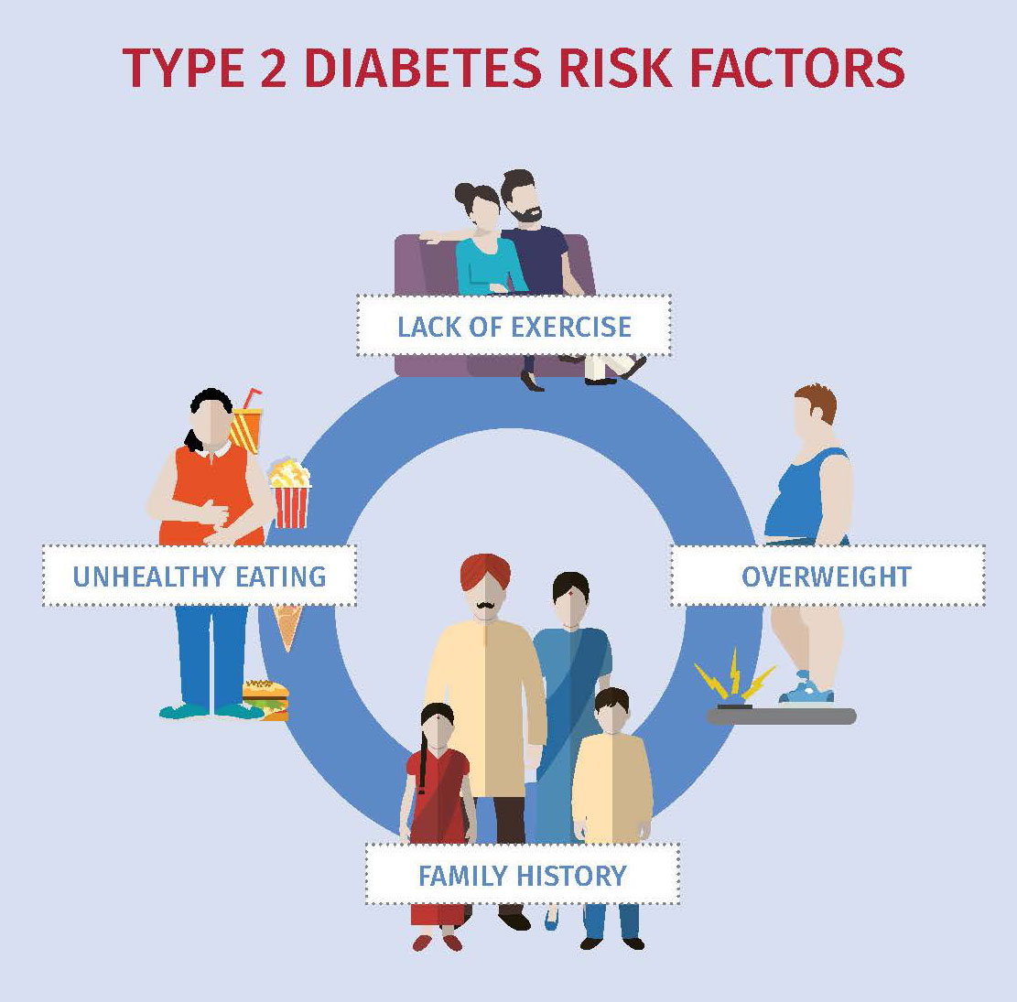
T2 Diabetes Risk Factors
Diabetes can be genetic, if a parent/sibling have diabetes
Pre diabetes **we will discuss this on the next slide**
Being inactive
Being overweight
Hypertension or high blood pressure
Heart disease
Good cholesterol is low <40
High Triglycerides >150
Females with gestational diabetes or PCOS
Age >45 increases the risk
Ethnicity

Slide 7
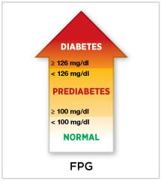
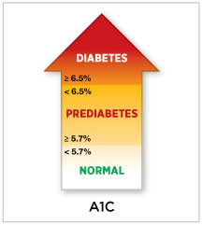
Pre Diabetes
What does this mean? When your blood sugar is higher then normal but not high enough to be considered having diabetes. A1C measures the percentage of blood sugar attached to the hemoglobin or the oxygen carrying red blood cells over 3 months.
Result | A1C
Normal | less than 5.7%
Prediabetes | 5.7% to 6.4%
Diabetes | 6.5% or higher

Slide 8
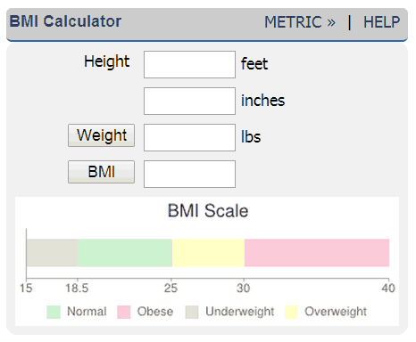
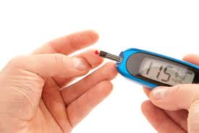
T2 Diabetes Management
Management is individualized for each person.
Weight
keep your BMI <25
BMI is the body mass index, a screening tool used to evaluate a healthy range of weight, over weight or obese
You may need to monitor and check your blood sugar/glucose daily
there are glucose monitors so you can check yourself at home
Before meals blood glucose should be between 80-130
The doctor will monitor your bloodwork such as A1C or your 3 month blood sugar
Normal levels are <6.5%
If blood sugar gets too low you can loose your ability to think clearly
If blood sugar gets too high and stays high this can damage body organs

Slide 9
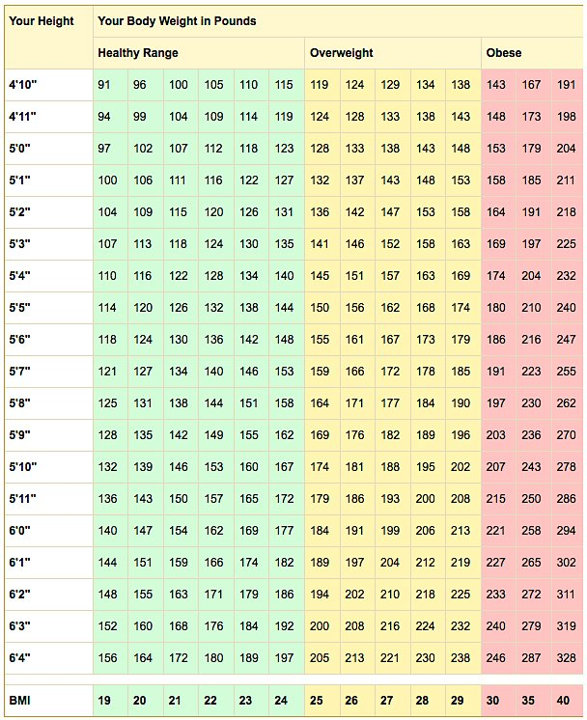
BMI: body mass index screening tool

Slide 10
T2 Diabetes Management
Diet
Watch carbohydrates like white rice/pasta/bread they will turn into sugar in the body
Eat more fruit, veggies, nuts, legumes, whole grains
Less sugary foods, like cakes, cookies, candy and sweet drinks like soda
Exercise
Walking, jogging, swimming, a fitness class, mowing the lawn, dancing, playing with your kids
It all counts, just move!
20-30 minutes every other day, start slow and gradually build up your tolerance.

Slide 11
Medication Management: classes
Biguinide (pill)
Metformin the most common and may be the first medication.
This works by improving the body’s sensitivity to insulin so the body uses insulin effectively this can sometimes cause GI upset
Sulfonylureas (pill)
This helps the body secrete more insulin this can sometimes cause a drop in blood sugar and weight gain, examples: Amaryl
DDP-4 Inhibitors (pill)
Helps reduce blood sugar but modestly, examples: Januvia,Onglyza,Trajenta
Insulin (injectable)
this may be needed if your body doesn’t produce enough insulin,examples: Novolin, Novolog
Meglitidines (pill)
Similar to sulfonylureas to help stimulate the pancreas to secrete more insulin this has a quicker reaction, examples: Prandin,Starlix
Thiazolidinediones (pill)
Like metformin, these medications make the body's tissues more sensitive to insulin, can cause to weight gain, examples: Avandia, Actos
GLP-1 (injectable)
Slows digestion to help lower blood sugar, can cause nausea, examples: Byetta, Victoza
SGLT-2 (injectable)
works by preventing the kidneys from absorbing the sugar it’s excreted in the urine, examples: Invokan, Farxiga
Mayoclinic.org, 2018

Slide 12
Diabetes Management
There are many medications that can help reduce blood sugar and many more new not mentioned. The reality is one needs to also help the body through a proper diet and exercise.

Slide 13
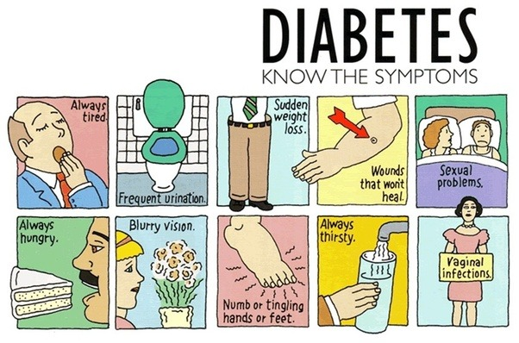
Complications
If blood sugar is not treated and stays too high it can cause many complications:
Blurred vision, eye damage
Sudden weight loss
Heart disease
Vascular problems
Non stop hunger
Nerve damage
Kidney problems
Foot damage
Fatigue
Vaginal infections
Skin conditions
Depression

Slide 14
Living with Diabetes
When a person is diagnosed with diabetes it can be traumatic. Talk to the provider let them know if you are struggling with this illness. Don’t ignore it!!
There is no cure for diabetes but one can manage the symptoms and delay or avoid the complications and a healthful life managing diabetes.
If you have questions ask the provider at your next visit at Pine Street Family Practice!

Slide 15
Resources
https://www.google.com/search?q=bmi+calculator&rlz=1C1RNVH_enUS540US541&oq=bmi+calcu&aqs=chrome.0.0j69i60j69i57j0l3.2693j1j7&sourceid=chrome&ie=UTF-8
http://www.diabetes.org/are-you-at-risk/prediabetes/
https://www.ncbi.nlm.nih.gov/books/NBK279141/
https://www.mayoclinic.org/diseases-conditions/diabetes/symptoms-causes/syc-20371444
https://www.mayoclinic.org/diseases-conditions/type-2-diabetes/diagnosis-treatment/drc-20351199
http://www.diabetes.org/assets/pdfs/basics/cdc-statistics-report-2017.pdf

