Slide 1

Welcome to Pine Street Family Practice’s Podcasts!!
New Series of Podcasts
A Few Topics
  Anxiety
  Diabetes
  Hypertension
  Dementia
  Obesity
  Nutrition
What will the podcast review?
  Brief information on a health topic
    Definition
    Signs and symptoms
    Risk Factors
    Treatments

Slide 2
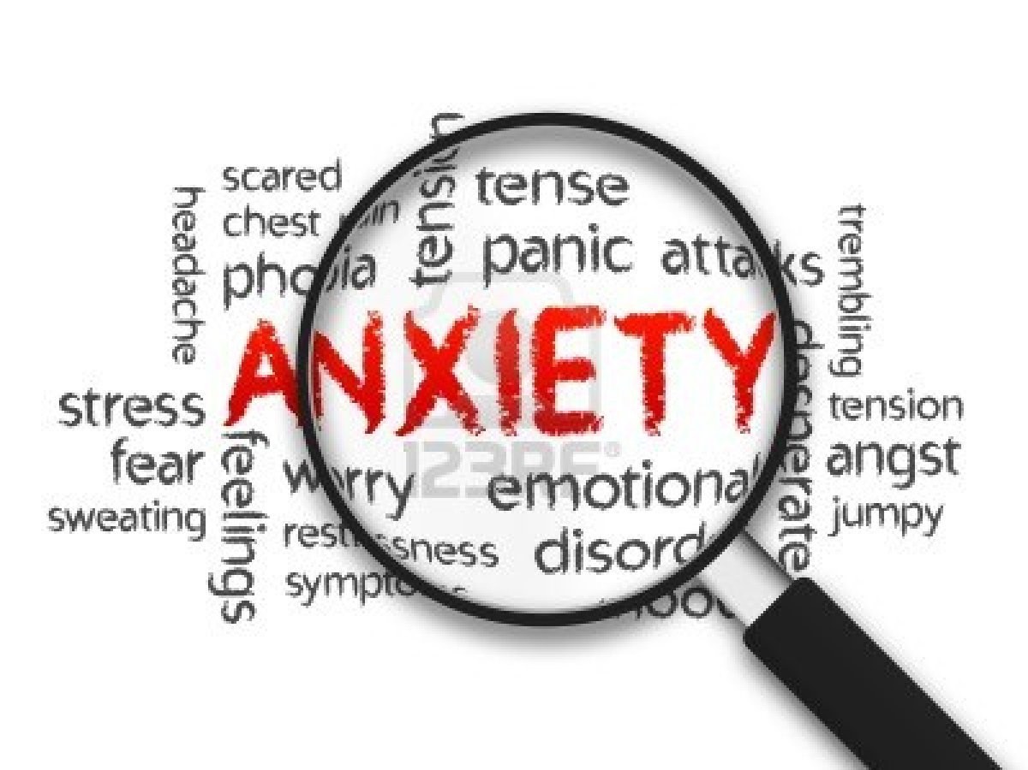
Anxiety
Maryanne Gallagher APN
Pine Street Family Practice

Slide 3
Facts
Anxiety disorders are the most common mental illness in the U.S.
  affecting 40 million adults in the United States age 18 and older
  Representing 18.1% of the population every year.
Anxiety disorders are treatable
  Only approximately 36% get treatment.
People with an anxiety disorders are:
  3-5x more likely to go to the doctor
  6x more likely to be hospitalized for psychiatric disorders than those who do not suffer from anxiety disorders.

Slide 4
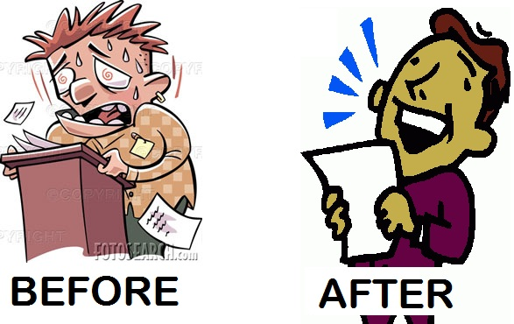
What is anxiety?
Some anxiety can be good for us…
anxiety can make us push ourselves as to study harder to get an “A” on a test or make us more alert and careful like paying attention to our surroundings when walking down a dark street alone. This type of anxiety usually ends soon after the situation that caused it has passed.
Some anxiety can be not good for us…
For millions of people in the United States, the anxiety does not go away after a stressful situation has pass and can become worse over time and sometimes develop into an anxiety disorders.
APA, 2018

Slide 5
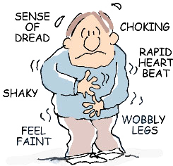
Sign and Symptoms
Emotional symptoms include:
Feelings of apprehension or fear
Feeling tense or jumpy
Restlessness or irritability
Anticipating the worst and being watchful for signs of danger
Physical symptoms include:
Racing heart and shortness of breath
Sweating, tremors and twitches
Headaches, fatigue and insomnia
GI issues, upset stomach, frequent urination, diarrhea

Slide 6
Anxiety Disorders
Different types include:
  Panic disorder
  Obsessive-compulsive disorder (OCD)
  Post-traumatic stress disorder (PTSD)
  Generalized anxiety disorder (GAD)
  Social anxiety disorder
Medline Plus 2018

Slide 7
GAD symptoms include:
Restlessness or feeling wound-up or on edge
Easily fatigued
Difficulty concentrating
Irritability
Muscle tension
Difficulty controlling being worried
Sleep problems
  difficulty falling or staying asleep or restless, unsatisfying sleep
www.nimh.nih.gov/health/topics/anxiety-disorders/index.shtml#part_145336

Slide 8
Panic Disorder symptoms include:
Sudden and repeated panic attacks of intense fear
Palpitations, a pounding heart, rapid heart rate, sweating, SOB
Feelings of being out of control during the attack
Intense worries
Fear of impending doom
Fear or avoidance of places where panic attacks have occurred in the past

Slide 9
Social Anxiety Disorder symptoms include:
People with social anxiety disorder or social phobia have a noticeable fear of social or performance situations in which once can anticipate feelings of embarrassed, judged, rejected, or fearful of offending others
Feeling anxious about being with other people
Feeling self-conscious in front of other people and worried about feeling humiliated, embarrassed, or rejected
Being afraid that other people will judge them
Worrying for days or weeks before an event where other people will be
Isolating ones self
Has a hard time making friends
Flushed, perspiring, or trembling around others
Feeling nauseous around other

Slide 10
Risk Factors
Behavioral self-consciousness, in childhood and sometimes in adulthood
Being female
Having few resources
Exposure to stressful life events in childhood and adulthood
Anxiety disorders in close biological relatives
  NIMH, 2018

Slide 11
Treatment
Anxiety disorders are generally treated with psychotherapy, medication, or both.
Psychotherapy is considered talk therapy. This can be directed to the specific needs and specific anxieties of an individual. It would be tailored to a typical “side effect” of psychotherapy is temporary discomfort involved with thinking about confronting feared situations, like, family situations.
  Cognitive Behavioral Therapy (CBT) is a type of psychotherapy
    can teach different ways of thinking, behaving, and reacting to anxious situations.
    Can teaches social skills
      Learning how to deal differently with specific situations

Slide 12
Treatment
Medications can help relieve symptoms.
Medication can only be prescribed by a medical doctor (such as a psychiatrist or a primary care provider)
  can be used as the initial treatment of an anxiety disorder, or are used only if there is insufficient response to a course of psychotherapy.
In research studies, combination treatments of psychotherapy and medication have had better outcomes then single treatment of psychotherapy or medication alone.

Slide 13
How can we manage symptoms
Meditation
  can help people calm themselves and may enrich the effects of therapy.
Aerobic exercise
  has a calming effect, although currently, the quality of the studies is not strong enough to support its use as a confirmed treatment.
Avoid certain substances
  caffeine, certain illicit drugs, and even some over-the-counter cold medications can aggravate symptoms.
Family
  People needs to be supportive in the recovery of a person with an anxiety disorder

Slide 14

Resources
In closing, people dx with anxiety and an anxiety disorder should not feel embarrassed or ashamed
If you or a loved one is suffering from one of these disorders help is available, do not be uncomfortable, ask for help at your next office visit at Pine Street Family Practice.
On line information is also available at: https://www.nimh.nih.gov/health/topics/anxiety-disorders/index.shtml#part_145353
https://www.nami.org/learn-more/mental-health-conditions/anxiety-disorders

